Slide 1
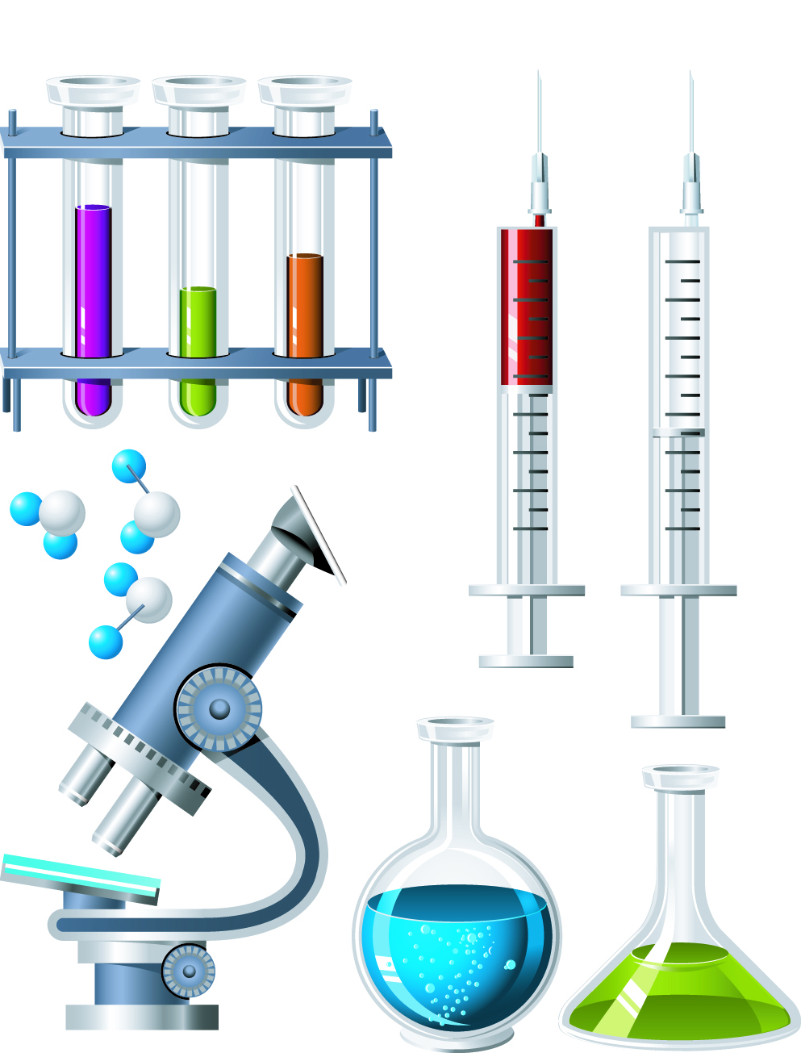
Chapter 2
Chemistry of Life
2.1 Organic Compounds
Learning Objectives for section 2.1 (part two):
Significance of Carbon
Carbohydrates
Lipids
Proteins
Nucleic Acids

Slide 2
The Significance of Carbon
Organic compounds are chemical substances that make up the cells and other structures of organisms and carry out life processes.
The main element in organic compounds is Carbon.
Carbon is basic to all life forms.
Why is Carbon so important? The reason is Carbon’s ability to form stable covalent bonds with many other elements.

Slide 3
Atomic number
Carbon’s atomic number is six so it has 6 protons in its nucleus and 6 electrons in its cloud.
Carbon’s atomic mass is 12 (rounded to the nearest whole number) so it has six neutrons in its nucleus as well.
Chemical Symbol
6
C
Carbon
12.011
Element Name
Atomic Mass Number
Number of Neutrons = atomic mass – atomic number

Slide 4
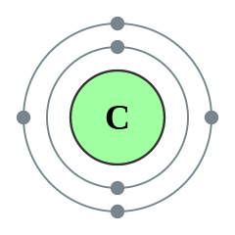
With 6 electrons, Carbon has 2 in its first electron shell which leaves 4 in its outer shell, its Valence Shell.
According to the Octet rule, atoms are most stable with 8 electrons in its Valence shell so:
Carbon has the ability to share its four valence electrons with up to 4 other elements.
6 +
Valence Shell

Slide 5
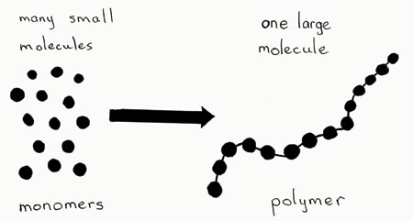
Carbon’s ability to form stable covalent bonds with many other elements, including itself, form the backbone of most organic compounds.
Organic compounds are
built of small repeating
units called monomers.
The monomers bond
with each other to form
the larger molecules
known as polymers.

Slide 6
Although there are millions of carbon based organic compounds found in living things, they can be grouped into four major types.
_______________________________________________________________________________________
1. _______________________________________________
2. _______________________________________________
3. _______________________________________________
4. _______________________________________________
Major Types of Organic Compounds
1. Carbohydrates
2. Lipids
3. Proteins
4. Nucleic Acids

Slide 7
1. Carbohydrate (structure)
Made up of elements of Carbon, Hydrogen and Oxygen in a ratio of 2 hydrogen to 1 oxygen.
Example:
C₆H₁₂O₆
Chemical formula for one glucose molecule. It has six carbon atoms bonded to twelve hydrogen atoms and six oxygen atoms.
Hydrogen atoms are double the Oxygen atoms

Slide 8
Carbohydrates
They are the most common type of organic compound.
They are compounds such as sugar and starch and are used to store energy.
Built of small repeating units, called monosaccharides.
1. the 3 monosaccharides are glucose, fructose, galactose
2. the monosaccharides are burned in a cells metabolism to provide energy for life processes.
3. monosaccharides are the monomers of carbohydrates
4. monosaccharide monomers bond together to form disaccharides or polysaccharides polymers.

Slide 9
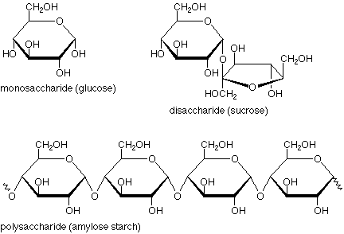
Carbohydrates
The atoms form a carbon ring.
Monosaccharide is one ring.
Two rings together is a disaccharide.
Many rings make a polysaccharide.

Slide 10
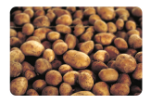
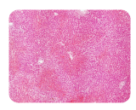
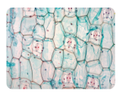
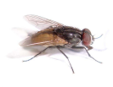
Starch | Used by plants to store energy | Starch grains in potato
Glycogen | Used by animals to store energy | Human liver cells
Cellulose | Used by plants to form rigid walls around cells. | Plant Cell walls
Chitin | Used by some animals to form an external exoskeleton | Insect exoskeleton
Complex Carbohydrates

Slide 11
2. Lipids (structure)
Made up of elements of Carbon, Hydrogen and Oxygen NOT in a ratio of 2 hydrogen to 1 oxygen.
Example:
C₁₂H₂₄O₂
Hydrogen atoms are NOT double the Oxygen atoms

Slide 12
Lipids
Do NOT dissolve in water (controls water movement in cells).
- phospholipids – major component in cell membranes
b. Built of small repeating units, called fatty acids.
1. fatty acids are the monomers of lipids.
2. fatty acids can be alone or combined with other molecules
a. triglycerides – main form of stored energy
- fat are solids at room temperature, animal storage
- oil is liquid at room temperature, plant storage
b. waxes – prevent water loss in plant leaves and stems
c. steroids – chemical messengers, venoms, and plant poisons

Slide 13
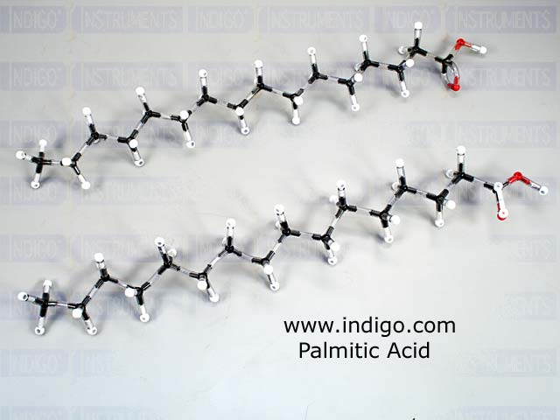
Fatty Acid – made up of a long, straight carbon/hydrogen chain with one carboxyl (COOH) group at one end.
hydrocarbon end is hydrophobic “water fearing”
carboxyl end is hydrophilic “water loving”

Slide 14
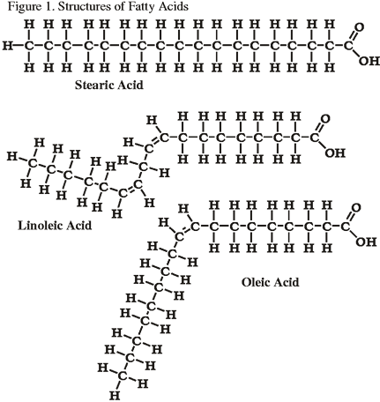
Saturated vs. Unsaturated Fatty Acids
(monomers of lipids)
1. Saturated Fatty Acid
(maximum hydrogens)
2. Polyunsaturated Fatty
Acid (4 less hydrogens)
3. Monounsaturated Fatty
Acid (2 less hydrogens)
Notice all fatty acids have one carboxyl group.

Slide 15
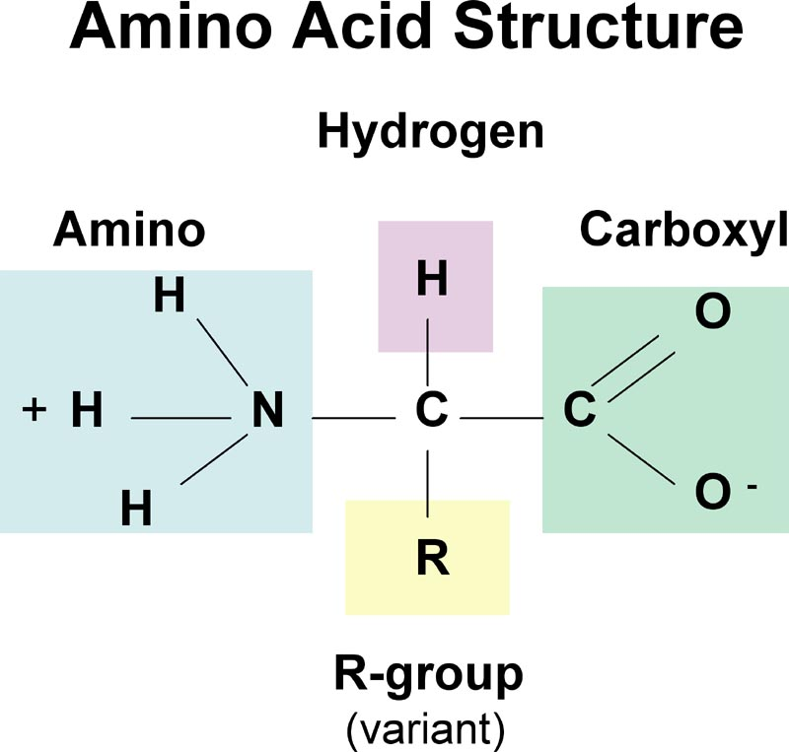
3. Proteins (structure)
Made up of elements of Carbon, Hydrogen and Oxygen, and Nitrogen
Proteins are made up of smaller
repeating units called Amino Acids.
There are only 20 different
Amino Acids and they all have a similar
structure. Only the “R” groups are
different.

Slide 16
Proteins
a. They serve as the structural materials for all organism.
They form enzymes that control chemical reactions in the body.
They form antibodies that fight foreign invaders.
d. They act as messengers or carriers (hemoglobin in blood)
e. Each protein has a specific shape. If it loses its shape it does
not work.
1. proteins are VERY sensitive to heat (lose shape)
2. proteins are Very sensitive to pH
f. Amino Acids are the monomers of proteins.
Amino acid monomers bond together to make polypeptides
polymers. There are four levels of protein structure.

Slide 17
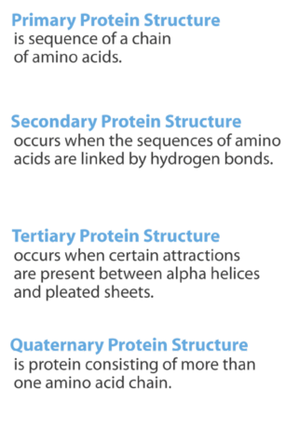

Slide 18
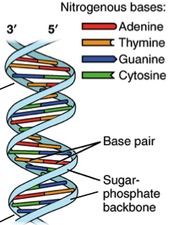
4. Nucleic Acids (structure)
Made up of elements of Carbon, Hydrogen
and Oxygen, Nitrogen, and Phosphorus
Organic compounds such as DNA and RNA.
DNA is short for Deoxyribonucleic Acid.
RNA is short for Ribonucleic Acid.
Both molecules are made up of smaller
units called nucleotides. These nucleotides
are the monomers of nucleic acids.
Double Helix – two polynucleotides spiraled together

Slide 19
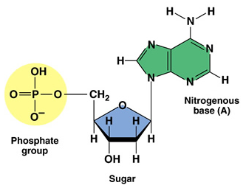
The nucleotide monomers are made up of
three smaller molecules:
1. A five carbon sugar
a. In DNA the sugar is Deoxyribo
b. In RNA the sugar is Ribose.
2. A nitrogen base (four different)
a. adenine
b. guanine
c. cytosine
d. thymine (in RNA it is uracil)
3. A phosphate group
Nucleotide

Slide 20
Nucleic Acids (DNA and RNA)
DNA is found in genes and holds the code for the correct
sequence of amino acids to make different proteins.
b. The information in DNA is passed from parent to offspring
during reproduction.
c. The RNA uses the information in DNA to build the proteins.
(DNA holds the instructions, RNA carries out those instructions)
d. The nucleotide monomers are bonded together to make a
polynucleotide polymer (one in RNA, two in DNA)

